Slide 1
Session 04
More on Classes and Nested Classes
Anonymous Classes
(http://docs.oracle.com/javase/tutorial/java/javaOO/more.html)
Session 4 - More on Classes and Nested Classes

Slide 2
Objectives
In this lesson you will learn:
  Controlling Access to Members of a Class using modifiers
  Overriding methods in sub-classes
  Nested Classes
Session 4 - More on Classes and Nested Classes

Slide 3
Review: Access Level
Modifier | Class | Same Package | Subclass- Outside package | World
private | Y | N | N | N
No (default) | Y | Y | N | N
protected | Y | Y | Y | N
public | Y | Y | Y | Y
Session 4 - More on Classes and Nested Classes

Slide 4
Tips on Choosing an Access Level
Use the most restrictive access level that makes sense for a particular member. Use private unless you have a good reason not to.
Avoid public fields except for constants. Public fields tend to link you to a particular implementation and limit your flexibility in changing your code.
Session 4 - More on Classes and Nested Classes

Slide 5
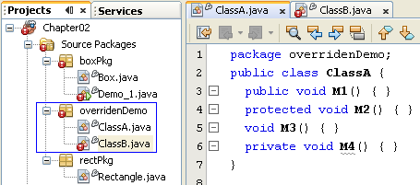
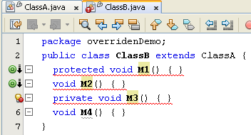
Access Modifier Overridden
Legal
private
default
protected
public
Illegal
public
protected
default
private
The sub-class must be more opened than it’s father
Session 4 - More on Classes and Nested Classes

Slide 6
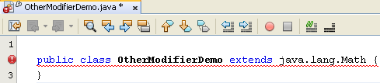
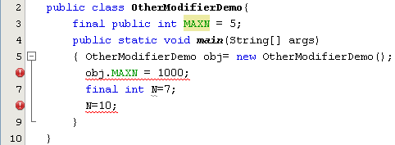
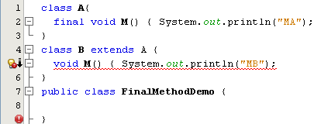
Modifier final
Final class: Class can not have sub-class
Final data is a constant.
Final method: a method can not be overridden.
Session 4 - More on Classes and Nested Classes

Slide 7
Modifier static
Class variable/ Object variable
Object variable: Variable of each object
Class Variable: A variable is shared in all objects of class. It is stored separately. It is declared with the modifier static
Class variable is stored separately. So, it can be accessed as:
object.staticVar
ClassName.staticVar
Session 4 - More on Classes and Nested Classes

Slide 8
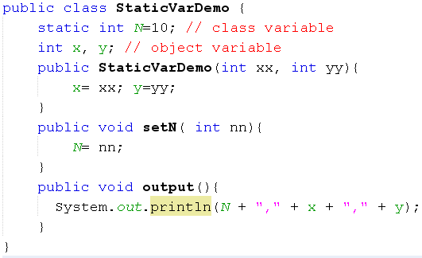
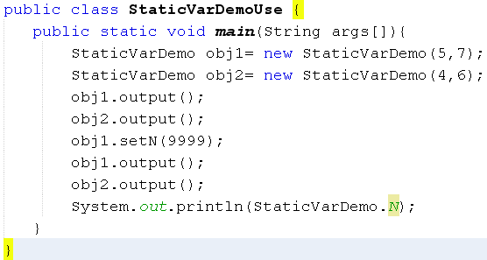
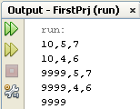
Modifier static:Class variable/ Object variable
y-=7
1000
x=5
y=6
800
x=4
obj1
1000
obj2
800
N
10 → 9999
Session 4 - More on Classes and Nested Classes

Slide 9
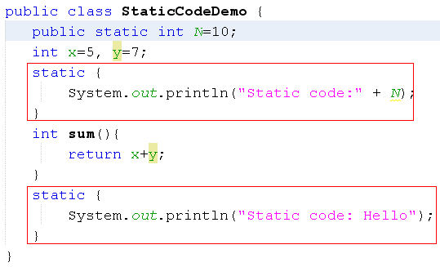
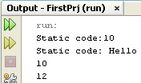
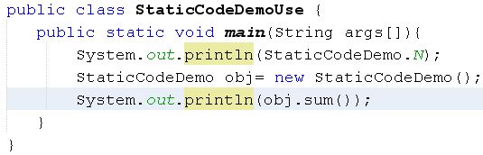
Modifier static: static code – Free Floating Block
All static code run only one time when the first time the class containing them is accesses
The second access
Session 4 - More on Classes and Nested Classes

Slide 10
Modifier static: Static method
It is called as class method/global method and it is called although no object of this class is created.
Entry point of Java program is a static method
Syntax for calling it: ClassName.staticMethod(args)
Static methods:
  can access class variables and class methods directly only.
  cannot access instance variables or instance methods directly—they must use an object reference.
  cannot use the this keyword as there is no instance for this to refer to.
Session 4 - More on Classes and Nested Classes

Slide 11
Modifier static:
Static code/ Free-floating block
What can free-floating block contain?
Initialize class (static) variable
Calling static methods with parameter
Session 4 - More on Classes and Nested Classes

Slide 12
Modifier static:
What should be static in a class?
Constants:
  The static modifier, in combination with the final modifier, is also used to define constants. The final modifier indicates that the value of this field cannot change.
  static final double PI = 3.141592653589793;
Session 4 - More on Classes and Nested Classes
Notes:
By convention, the names of constant values are spelled in uppercase letters. If the name is composed of more than one word, the words are separated by an underscore (_).

Slide 13
Initializing Fields (3)
Initializing Instance Members
  Will be copied initializer blocks into every constructor.
  Can be used to share a block of code between multiple constructors.
  Initializer blocks for instance variables look just like static initializer blocks, but without the static keyword:
  {
  // whatever code is needed for initialization goes here
  }
Session 4 - More on Classes and Nested Classes

Slide 14
Inner(Nested) Classes

Slide 15
Simple Uses of Inner Classes
Inner classes are classes defined within other classes
  The class that includes the inner class is called the outer class
  There is no particular location where the definition of the inner class (or classes) must be place within the outer class
  Placing it first or last, however, will guarantee that it is easy to find
Session 4 - More on Classes and Nested Classes

Slide 16
Simple Uses of Inner Classes
An inner class definition is a member of the outer class in the same way that the instance variables and methods of the outer class are members
  An inner class is local to the outer class definition
  The name of an inner class may be reused for something else outside the outer class definition
  If the inner class is private, then the inner class cannot be accessed by name outside the definition of the outer class
Session 4 - More on Classes and Nested Classes

Slide 17
Inner/Outer Classes
public class Outer
{
private class Inner
{
// inner class instance variables
// inner class methods
} // end of inner class definition
// outer class instance variables
// outer class methods
}
Session 4 - More on Classes and Nested Classes

Slide 18
Simple Uses of Inner Classes
There are two main advantages to inner classes
  They can make the outer class more self-contained since they are defined inside a class
  Both of their methods have access to each other's private methods and instance variables
Using an inner class as a helping class is one of the most useful applications of inner classes
  If used as a helping class, an inner class should be marked private
Session 4 - More on Classes and Nested Classes

Slide 19
Inner and Outer Classes Have Access to Each Other's Private Members
Within the definition of a method of an inner class:
  It is legal to reference a private instance variable of the outer class
  It is legal to invoke a private method of the outer class
  Essentially, the inner class has a hidden reference to the outer class
Within the definition of a method of the outer class
  It is legal to reference a private instance variable of the inner class on an object of the inner class
  It is legal to invoke a (nonstatic) method of the inner class as long as an object of the inner class is used as a calling object
Within the definition of the inner or outer classes, the modifiers public and private are equivalent
Session 4 - More on Classes and Nested Classes

Slide 20
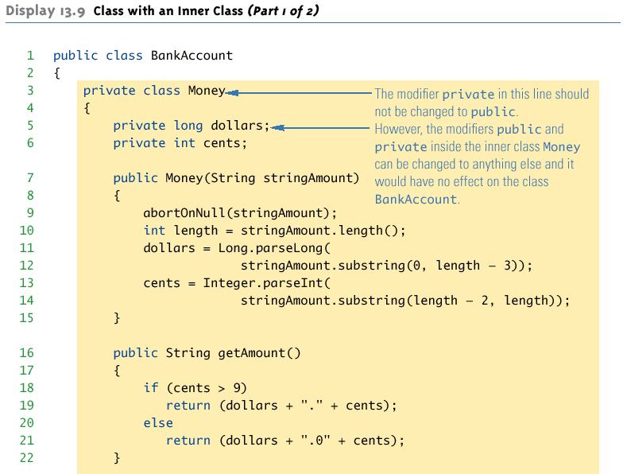
Class with an Inner Class Example - 1
Session 4 - More on Classes and Nested Classes

Slide 21
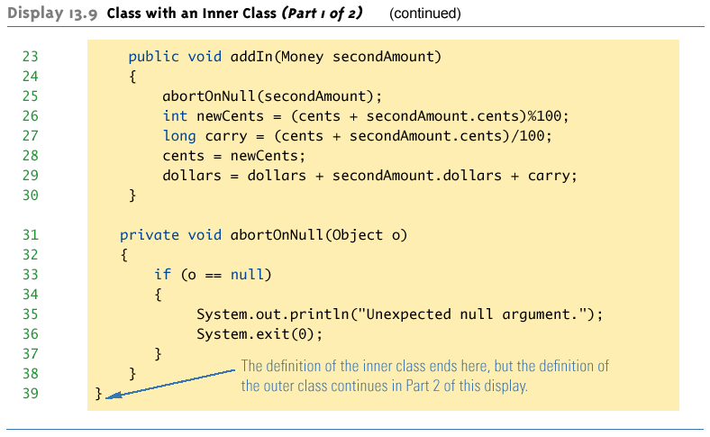
Class with an Inner Class Example - 2
Session 4 - More on Classes and Nested Classes

Slide 22
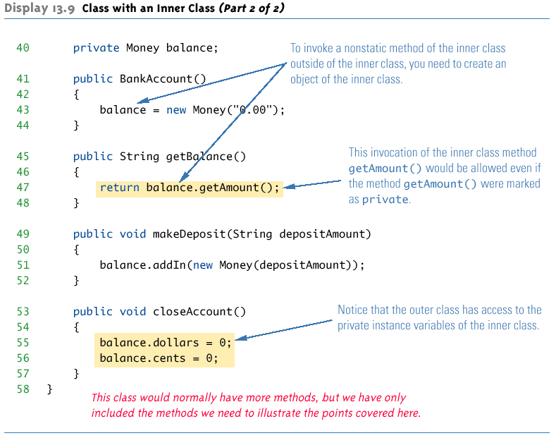
Class with an Inner Class Example - 3
Session 4 - More on Classes and Nested Classes

Slide 23
Referring to a Method of the Outer Class
If a method is invoked in an inner class
  If the inner class has no such method, then it is assumed to be an invocation of the method of that name in the outer class
  If both the inner and outer class have a method with the same name, then it is assumed to be an invocation of the method in the inner class
  If both the inner and outer class have a method with the same name, and the intent is to invoke the method in the outer class, then the following invocation must be used:
    OuterClassName.this.methodName()
Session 4 - More on Classes and Nested Classes

Slide 24
Public Inner Classes
If an inner class is marked public, then it can be used outside of the outer class
In the case of a nonstatic inner class, it must be created using an object of the outer class
    BankAccount account = new BankAccount();
    BankAccount.Money amount =
    account.new Money("41.99");
  Note that the prefix account. must come before new
  The new object amount can now invoke methods from the inner class, but only from the inner class
Session 4 - More on Classes and Nested Classes

Slide 25
Public Inner Classes (cont.)
In the case of a static inner class, the procedure is similar to, but simpler than, that for nonstatic inner classes
    OuterClass.InnerClass innerObject =
    new OuterClass.InnerClass();
  Note that all of the following are acceptable
    innerObject.nonstaticMethod();
    innerObject.staticMethod();
    OuterClass.InnerClass.staticMethod();
Session 4 - More on Classes and Nested Classes

Slide 26
Public Money Inner Class
If the Money inner class in the BankAccount example was defined as public, we can create and use objects of type Money outside the BankAccount class.
// this is okay in main( )
BankAccount account = new BankAccount( );
BankAccount.Money amt = // note syntax
account.new Money( “41.99” );
System.out.println( amt.getAmount( ) );
// but NOT this – why not??
System.out.println( amt.getBalance( ) );
Session 4 - More on Classes and Nested Classes
Notes:
amt.getBalance( ) is illegal because getBalance( ) is a method of BankAccount, not Money

Slide 27
Static Inner Classes
A normal inner class has a connection between its objects and the outer class object that created the inner class object
  This allows an inner class definition to reference an instance variable, or invoke a method of the outer class
There are certain situations, however, when an inner class must be static
  If an object of the inner class is created within a static method of the outer class
  If the inner class must have static members
Session 4 - More on Classes and Nested Classes

Slide 28
Static Inner Classes (cont.)
Since a static inner class has no connection to an object of the outer class, within an inner class method
  Instance variables of the outer class cannot be referenced
  Nonstatic methods of the outer class cannot be invoked
To invoke a static method or to name a static variable of a static inner class within the outer class, preface each with the name of the inner class and a dot
Session 4 - More on Classes and Nested Classes

Slide 29
Multiple Inner Classes
A class can have as many inner classes as it needs.
Inner classes have access to each other’s private members as long as an object of the other inner class is used as the calling object.
Session 4 - More on Classes and Nested Classes

Slide 30
The .class File for an Inner Class
Compiling any class in Java produces a .class file named ClassName.class
Compiling a class with one (or more) inner classes causes both (or more) classes to be compiled, and produces two (or more) .class files
  Such as ClassName.class and ClassName$InnerClassName.class
Session 4 - More on Classes and Nested Classes

Slide 31
Nesting Inner Classes
It is legal to nest inner classes within inner classes
  The rules are the same as before, but the names get longer
  Given class A, which has public inner class B, which has public inner class C, then the following is valid:
    A aObject = new A();
    A.B bObject = aObject.new B();
    A.B.C cObject = bObject.new C();
Session 4 - More on Classes and Nested Classes

Slide 32
Inner Classes and Inheritance
Given an OuterClass that has an InnerClass
  Any DerivedClass of OuterClass will automatically have InnerClass as an inner class
  In this case, the DerivedClass cannot override the InnerClass (This is not true for JDK 8, noted by caupd).
An outer class can be a derived class
An inner class can be a derived class also
Session 4 - More on Classes and Nested Classes

Slide 33
Anonymous Classes
If an object is to be created, but there is no need to name the object's class, then an anonymous class definition can be used
  The class definition is embedded inside the expression with the new operator
  An anonymous class is an abbreviated notation for creating a simple local object "in-line" within any expression, simply by wrapping the desired code in a "new" expression.
Anonymous classes are sometimes used when they are to be assigned to a variable of another type
  The other type must be such that an object of the anonymous class is also an object of the other type
  The other type is usually a Java interface
  Not every inner class should be anonymous, but very simple "one-shot" local objects are such a common case that they merit some syntactic sugar.
Session 4 - More on Classes and Nested Classes

Slide 34
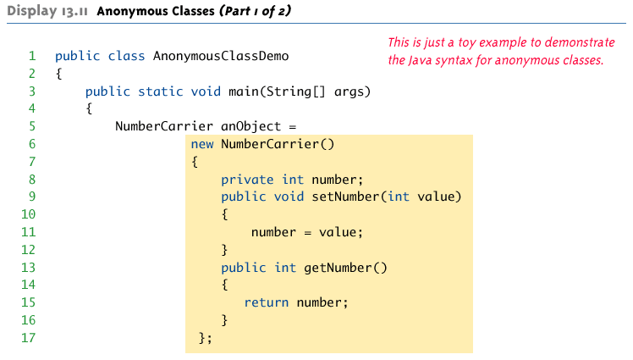
Anonymous Class Example - 1
Session 4 - More on Classes and Nested Classes

Slide 35
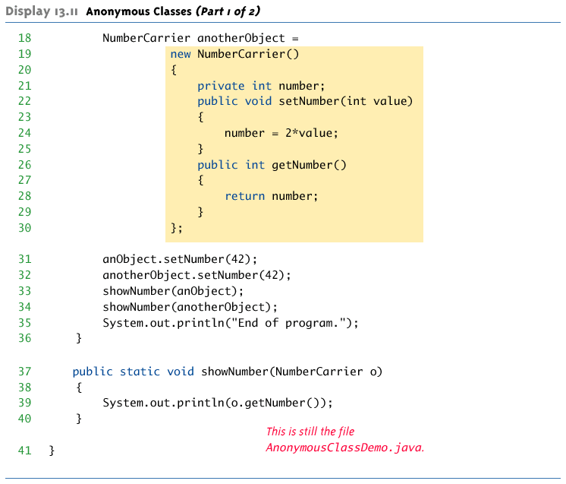
Anonymous Class Example - 2
Session 4 - More on Classes and Nested Classes

Slide 36
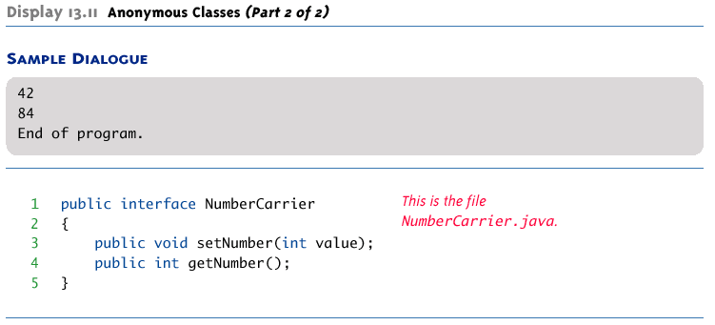
Anonymous Class Example - 3
Session 4 - More on Classes and Nested Classes

Slide 37
Shadowing
Declaration of a type in a particular scope has the same name as another declaration in the enclosing scope, then the declaration shadows the declaration of the enclosing scope.
Session 4 - More on Classes and Nested Classes

Slide 38

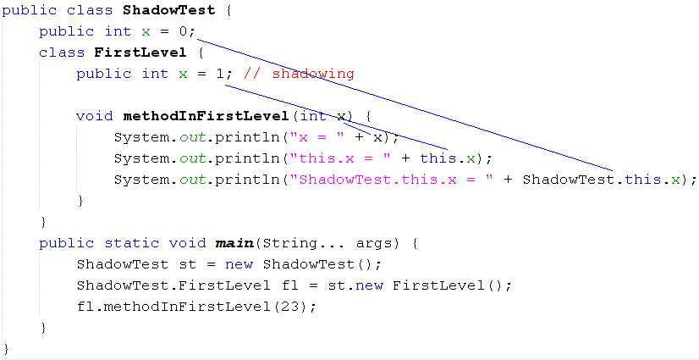
Shadowing Variable
Mechanism: Local data is treated first
Session 4 - More on Classes and Nested Classes

Slide 39
Summary
  Overriding methods in sub-classes
  Controlling Access to Members of a Class using modifiers
  Nested Classes
Session 4 - More on Classes and Nested Classes

